Slide 1
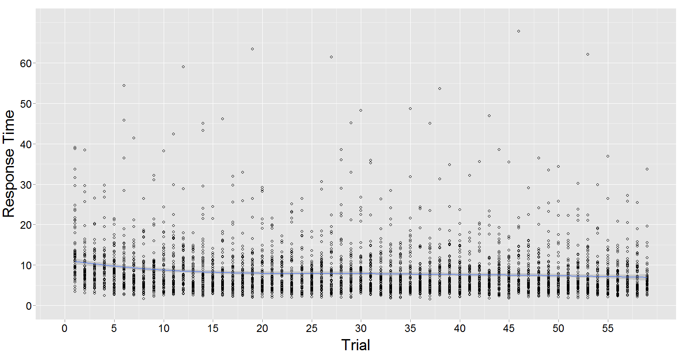

Slide 2
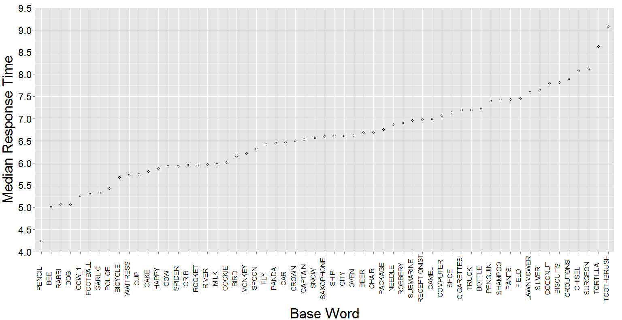
TOOTHBRUSH, COMB, FLOSS, CAKE, CUP, GLASSES
TORTILLA, BAGEL, BEANS, COLD, KNOB, SALESMAN
PENCIL, PEN, ERASER, FLUTE, MINT, SHEEP

Slide 3
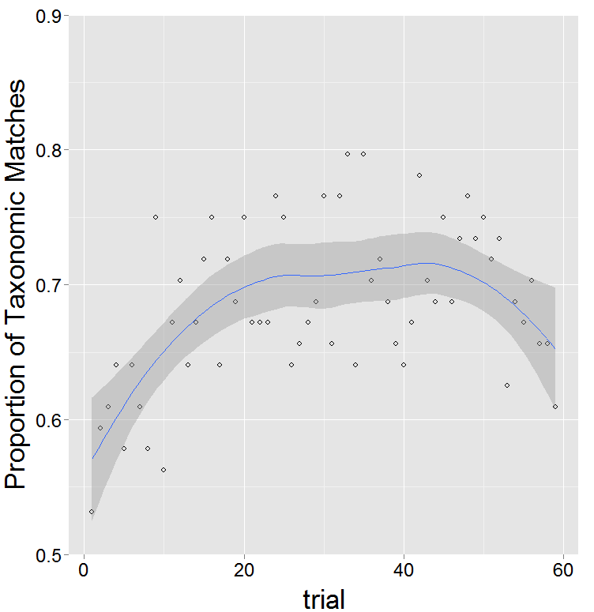

Slide 4
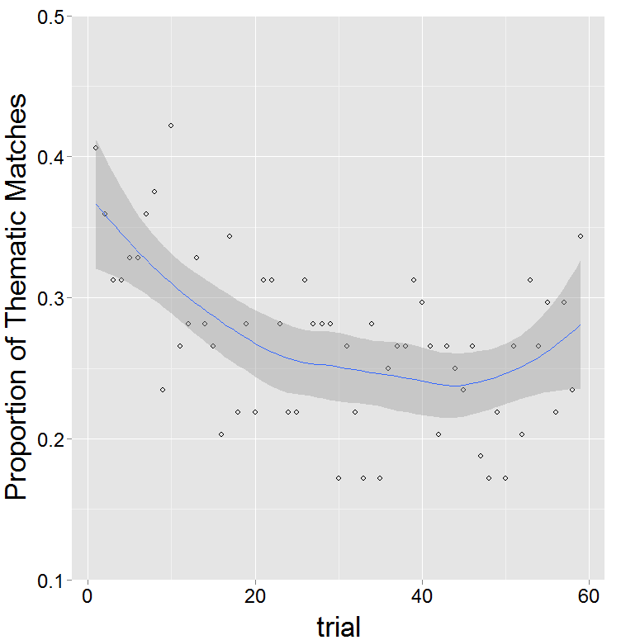

Slide 5
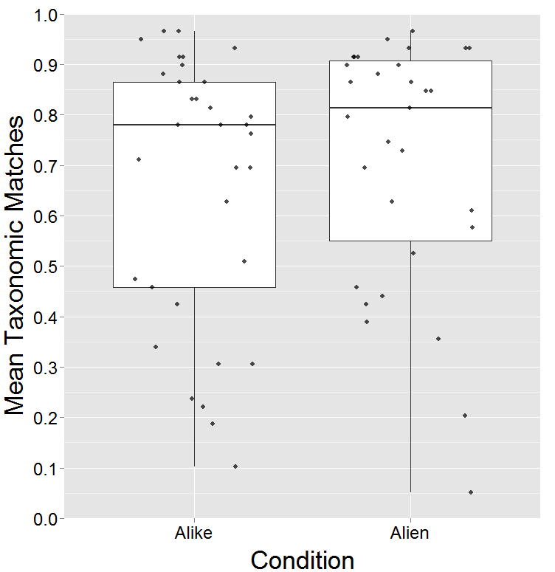

Slide 6
Hello! In this study, you are going to see a series of different sets of items (words). For each set, your goal is to find two items in the set that are *most alike*. When you've chosen the two items that are most alike, use the mouse to select the items and then press continue to confirm your selection.
Hello! In this study, you are trying to teach an alien from outer space about life on earth. Specifically, you need to teach the alien about things that we have on earth that are similar to each other. We will be showing you a series of different sets of items (words). Can you demonstrate to your alien friend which pair of items in each set are things that are similar to one another? When you've chosen the two items that are most similar, use the mouse to select the items and then press continue to confirm your selection.

